Slide 1


Challenges in Prostate Cancer: Are there mathematical solutions?
Peter L. Choyke MD and Baris Turkbey MD
Molecular Imaging Program, National Cancer Institute
National Institutes of Health, Bethesda, MD

Slide 2
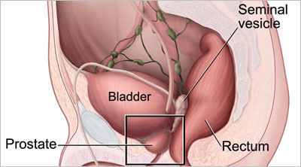
Prostate cancer
Prostate cancer occurs in the prostate gland
Located in the pelvis below the bladder
Necessary for fertility
Size of a walnut originally but can grow with age
Notes:
Image guided biopsy
Image guided focal therapy

Slide 3
Natural History of Prostate Cancer
Death
Castration
Castration
Resistance
Local Therapy
Tumor volume
2nd-line Hormonal therapy
Localized
Biochemical recurrence
Castration Sensitive
Castration Resistant Metastases
Non-Metastatic
Metastatic
Castration Sensitive
Castration Resistant
Time

Slide 4
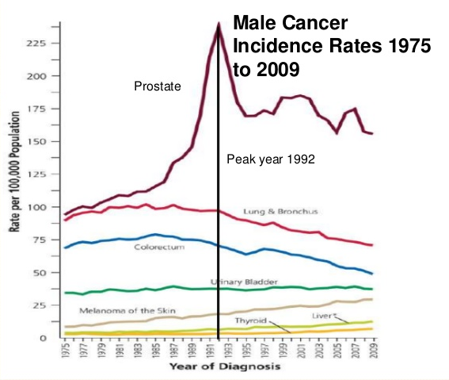
Prostate cancer
Most common cancer in men
233,000 new cases in the US in 2014
1 in 6 men will be diagnosed with prostate cancer in their life
Second leading cause of cancer death in US men
Notes:
Image guided biopsy
Image guided focal therapy

Slide 5
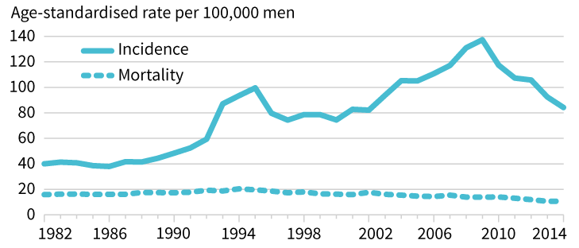
Prostate cancer
90% of men diagnosed with prostate cancer will die of other causes
Improved risk stratification needed to differentiate:
Aggressive, lethal prostate cancer
Clinically insignificant, non-lethal prostate cancer
Major clinical challenge remains treating men with aggressive cancer, but not overtreating men with clinically insignificant cancer
Notes:
Image guided biopsy
Image guided focal therapy

Slide 6
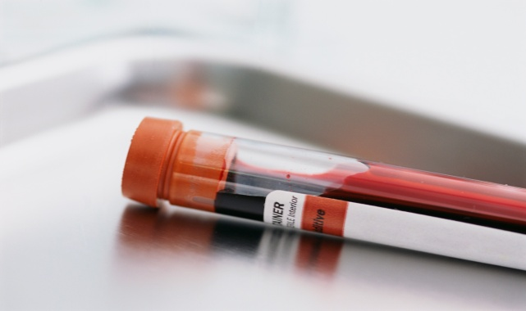
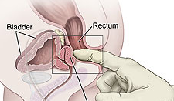
How is prostate cancer diagnosed?
PSA (prostate-specific antigen)
PSA produced in normal prostate and prostate cancer
Cancer makes much more than normal prostate
High levels raise suspicion for cancer
Digital rectal exam
Doctor feels the surface of the prostate gland for bumps, hard spots, and any other abnormalities

Slide 7
Prostate Cancer By the Numbers
233,000 New Diagnoses
29,480 Deaths from Prostate Cancer
1 in 7 Men diagnosed with PCa during life
1 in 36 Men will die of PCa
66 The average age of diagnosis

Slide 8
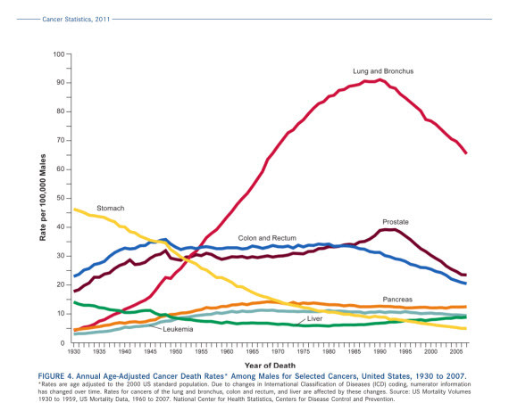
Death Rates of Common Cancers in the United States

Slide 9

Prevention
Known or suspected risk factors:
Diet rich in animal fats
Obesity
Genetics
Climate-sunlight

Slide 10

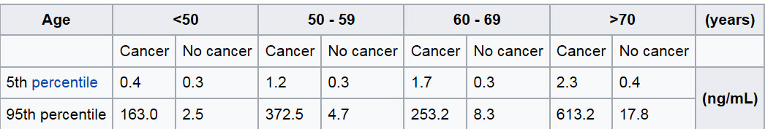
Screening
Prostate Specific Antigen

Slide 11
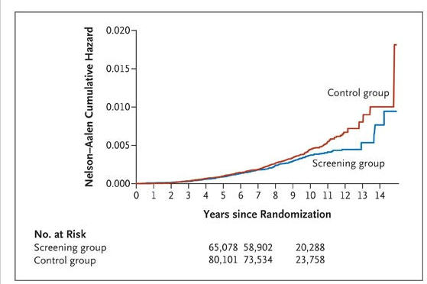

Slide 12
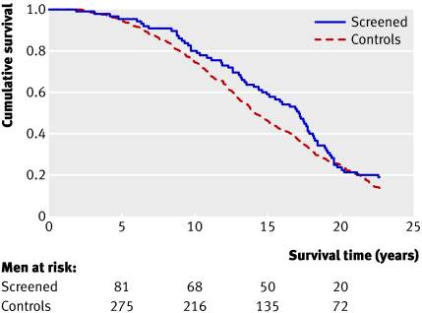

Slide 13
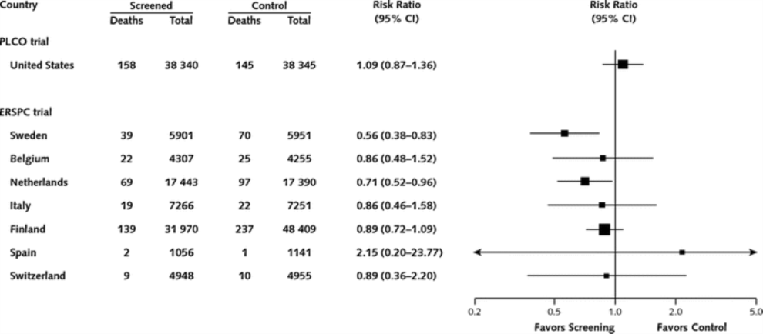
The Data USPSTF Considered Modest survival benefit at huge QOL cost
Was contamination a problem?
Ann Intern Med. 2012;157(2):120-134. doi:10.7326/0003-4819-157-2-201207170-00459

Slide 14
Death Rates of Common Cancers in the United States
PSA Begins
PSA Ends
???

Slide 15
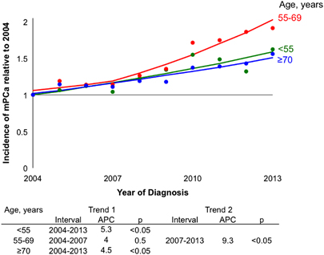
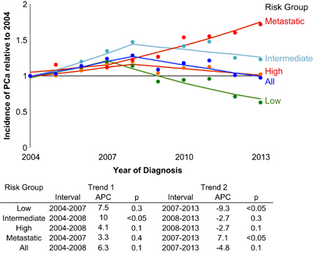
FROM:
Increasing incidence of metastatic prostate cancer in the United States (2004–2013)
A B Weiner, R S Matulewicz, S E Eggener and E M Schaeffer Prost Cancer and Prost Dis 2016

Slide 16
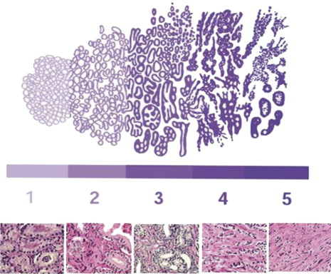

Slide 17
What is clinically significant cancer?
Prostate Cancer that is likely to progress and affect a man’s life expectancy.
cancers of higher Gleason score of 7 with significant amount of “4” (i.e. 4+3 or higher)
larger volume disease is more likely to be clinically significant; a commonly used threshold is a tumor volume above 0.5ml
Consider life expectancy varies (10 years is a general rule)

Slide 18
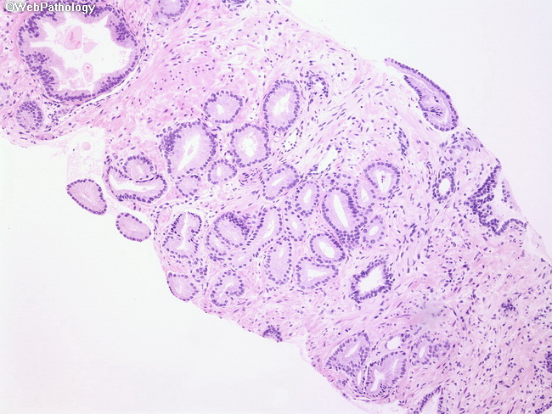
Gleason 3+3

Slide 19
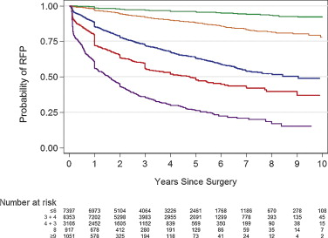
Who to treat?
Gleason Scoring System: Still the best predictor of biology
Limited by undersampling with 23-35% upgrading at surgery with standard TRUS biopsy
Image guided biopsies reduce upgrading to 5-10%
International Society of Genitourinary Pathologists Scoring System
ISUP group 1= 3+3
ISUP group 2= 3+4
ISUP group 3= 4+3
ISUP group 4= 4+4, 3+5, 5+3
ISUP group 5= 4+5, 5+5, 5+4
VanderWeele et al Expert Reviews in Precision Medicine 2016
Epstein J Urology 2015

Slide 20
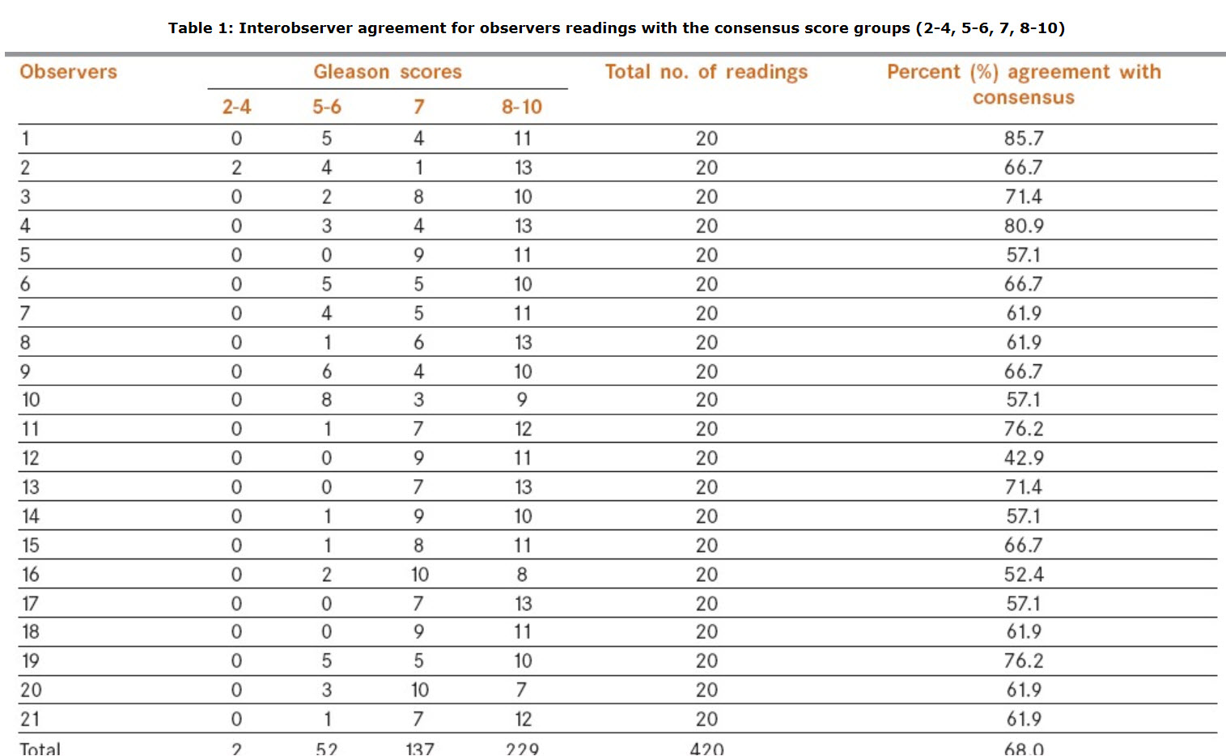
Interobserver Variability

Slide 21
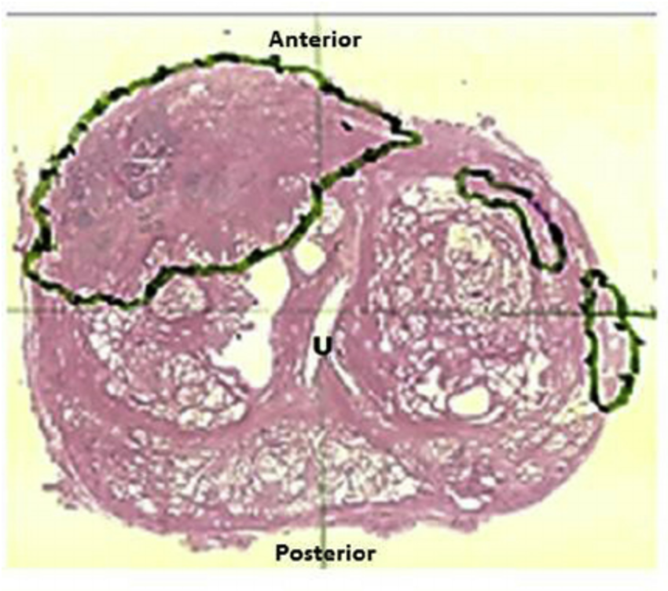
Tumor Heterogeneity

Slide 22
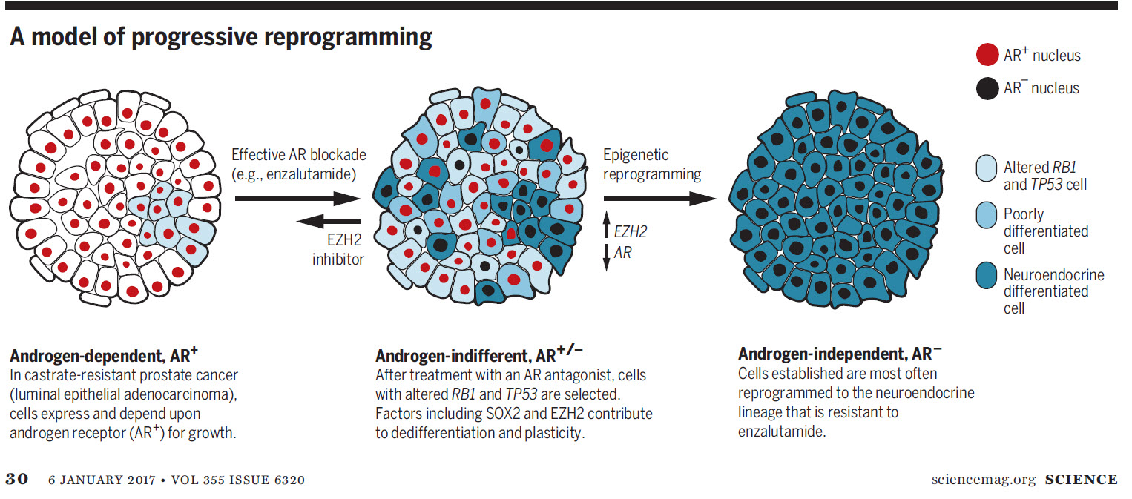

Slide 23
Summary of Prostate Cancer Histology
Broad spectrum of tumor aggressiveness from indolent to lethal
Current method of assessment is based on the Gleason system which is subjective and has reproducibility issues
There is considerable tumor heterogeneity; a given biopsy could yield a broad spectrum of aggressiveness
Biology is determined by “worst” histology
Cancer evolves as treatments are applied.

Slide 24
Underdiagnosis with TRUS-Bx
The problem is not just with PSA: The Random TRUS Bx
Poor Sampling Anterior lesion Anterior-midline Highly lateral
Over diagnosis with TRUS-Bx
Courtesy: Caroline Moore UCL

Slide 25
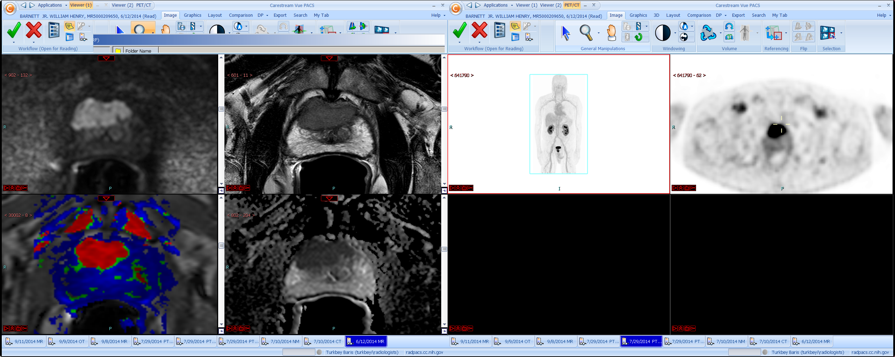
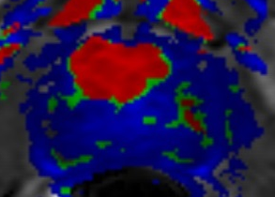
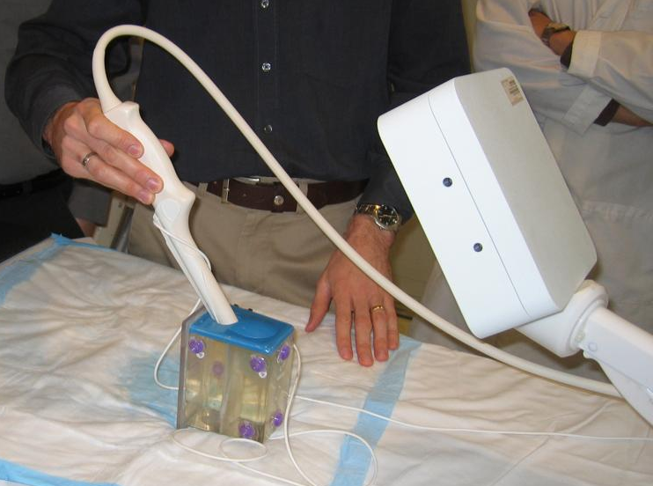
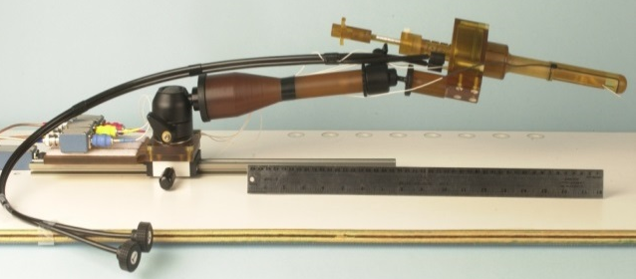

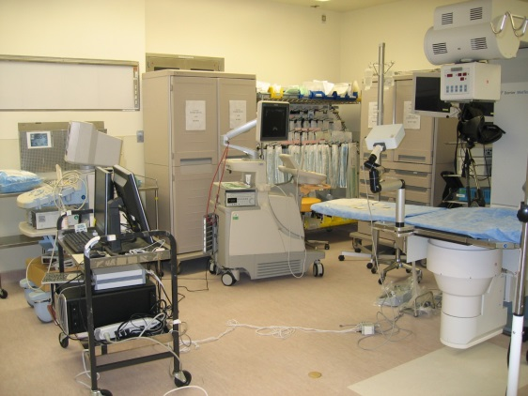
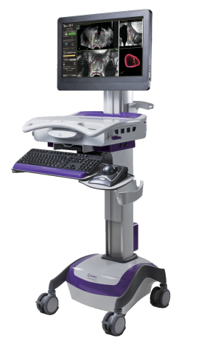
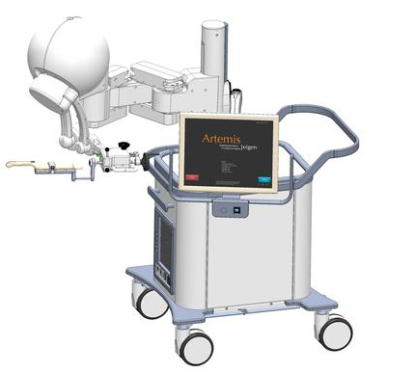
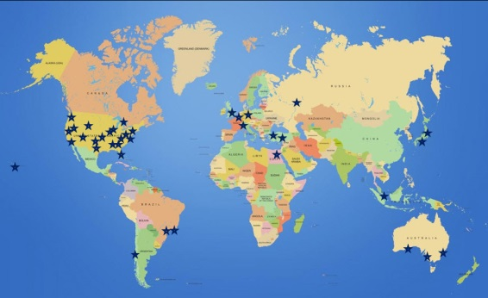
The Development of Prostate Imaging and Image Guided Biopsy 2000-2016
Multiparametric MRI 2000’s
In gantry biopsy 2003-6
MRI-TRUS-GPS-2006
Clinic MR-TRUS Fusion 2008
Commercial MR-TRUS fusion
Devices 2013
World wide- Image
Guided Bx (IGB) 2016

Slide 26
Why MRI is Needed?
The combination of PSA screening and blind bx resulted in the discovery of too many inconsequential lesions leading to overtreatment defined as:
Minimal gain in survival
At a huge cost in Quality of Life/Cost to Society
PSA with MRI can direct biopsy to MR targets increasing detection of CS lesions and decreasing detection of NCS lesions

Slide 27
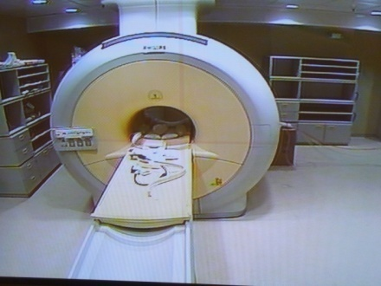
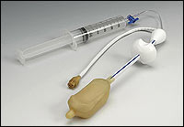
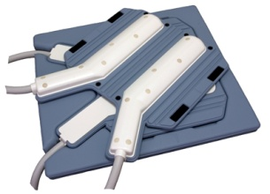
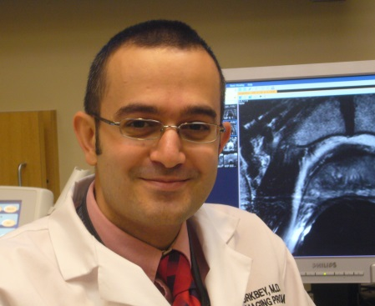
Multi-parametric Prostate MRI
510 patients/3 years
10 patients/week
Endorectal coil
16-channel cardiac coil
3 Tesla MRI
Baris Turkbey, MD

Slide 28
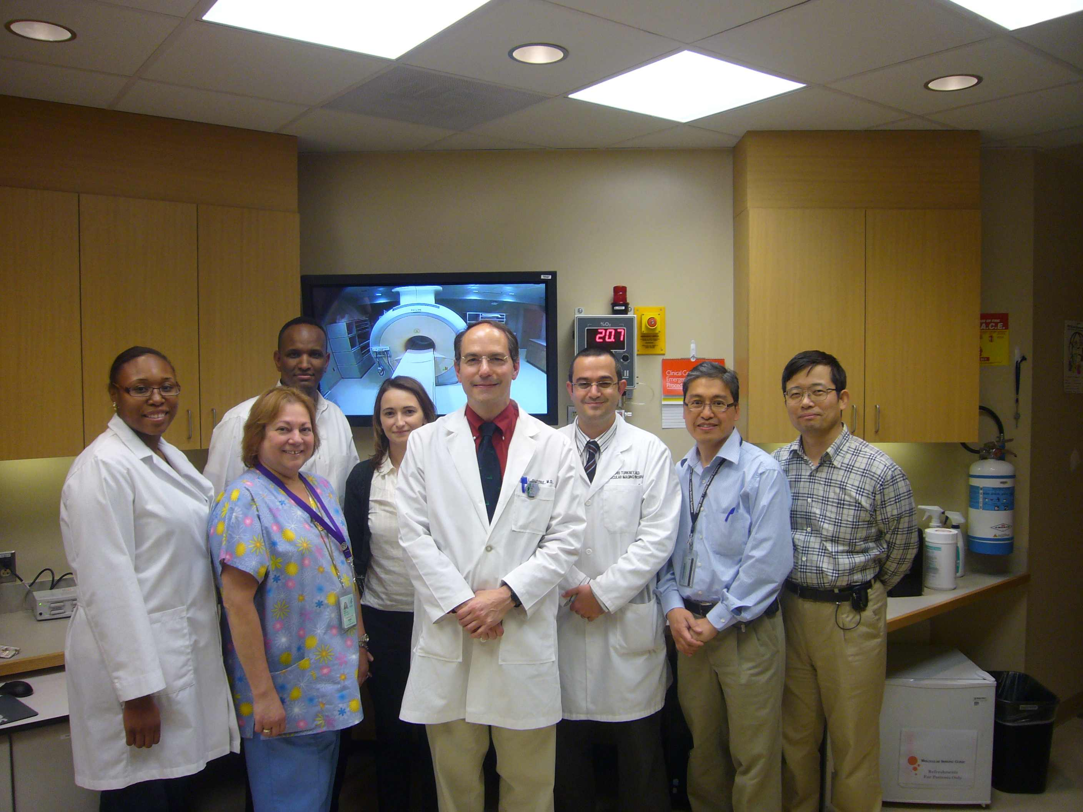

Slide 29
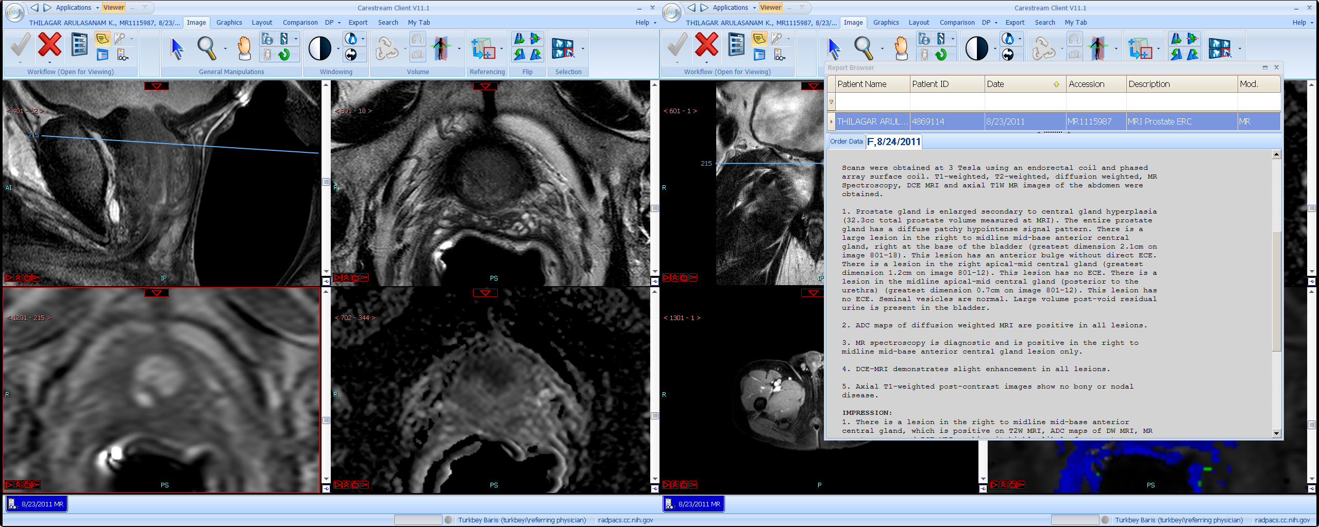
*
64 y.o. with rising
PSA
1
Midline base anterior central gland lesion
T2 +
DWI +
DCE +
MRS +
High suspicious
Please use series 801 for targets
*
*
Notes:
13. Prostate, MR midline base anterior central axial, biopsy:
Adenocarcinoma, Gleason's score 6 (3+3), involving 10% of 1 core.
14. Prostate, MR midline base anterior central sagittal, biopsy:
Intestinal epithelium.

Slide 30
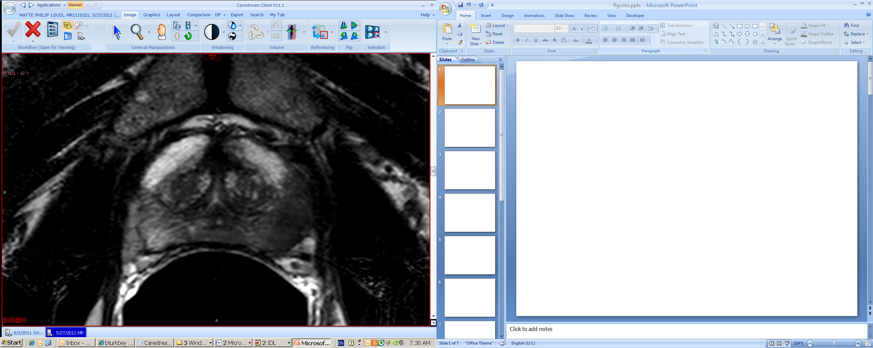
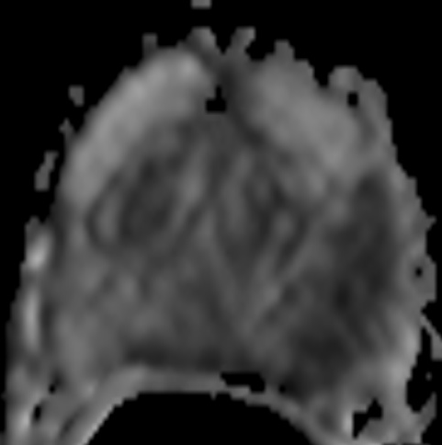
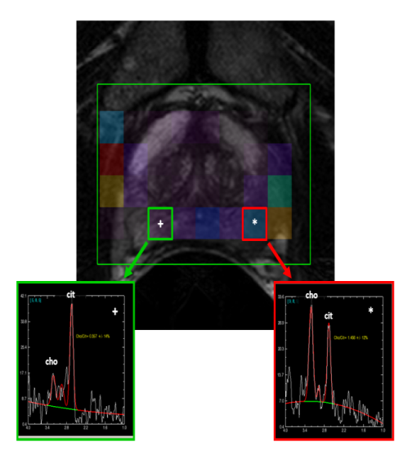
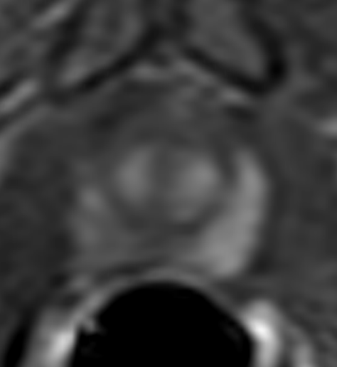
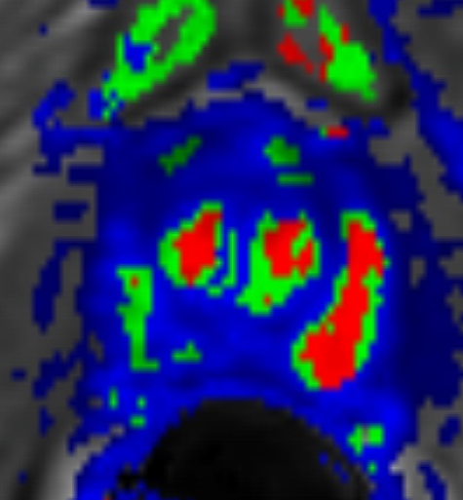
66-year-old man with a serum PSA of 5.9nd/dL and Gleason 3+4 tumor within left mid peripheral zone at transrectal ultrasound guided biopsy
T2W MRI
ADC map
MR spectroscopy
Turkbey et al. Radiology 2010
Turkbey et al. Journal of Urology 2011
Turkbey et al. Journal of Urology 2012
Turkbey et al. Radiology 2013
Turkbey et al. JMRI 2013
Raw DCE MRI
Ktrans map of DCE MRI

Slide 31
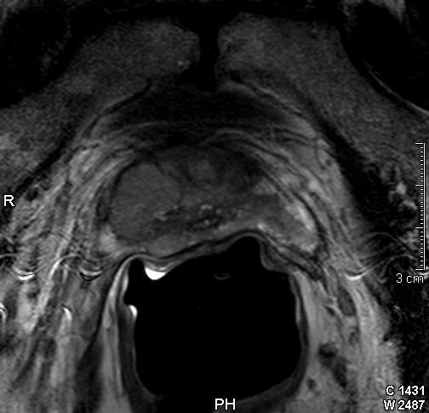
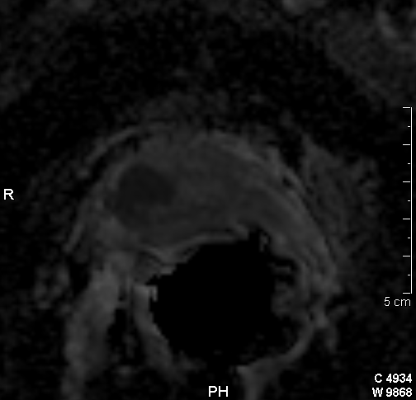
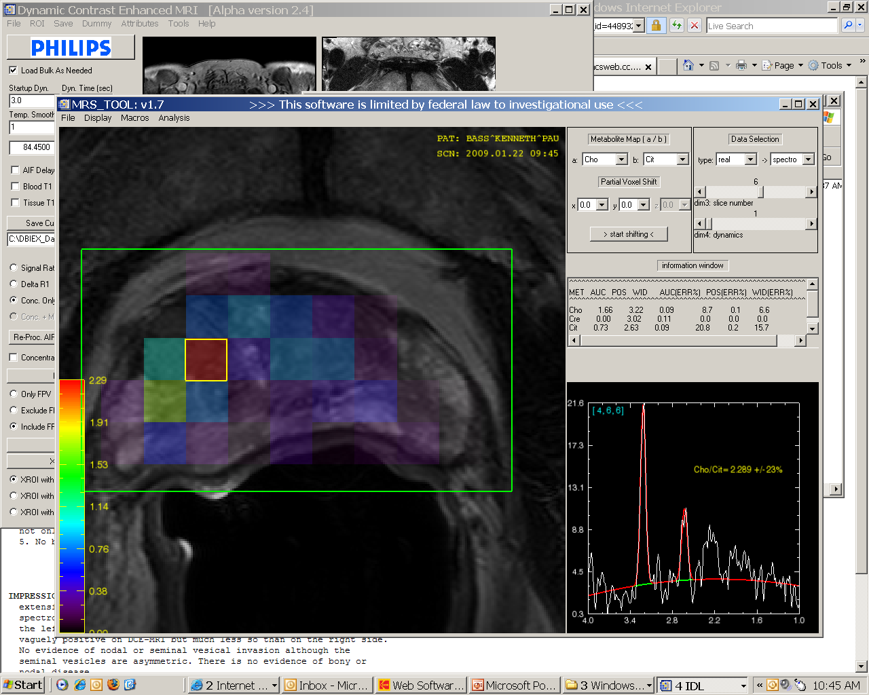
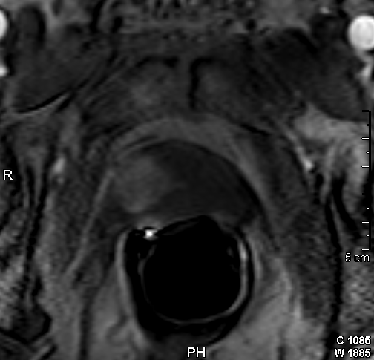
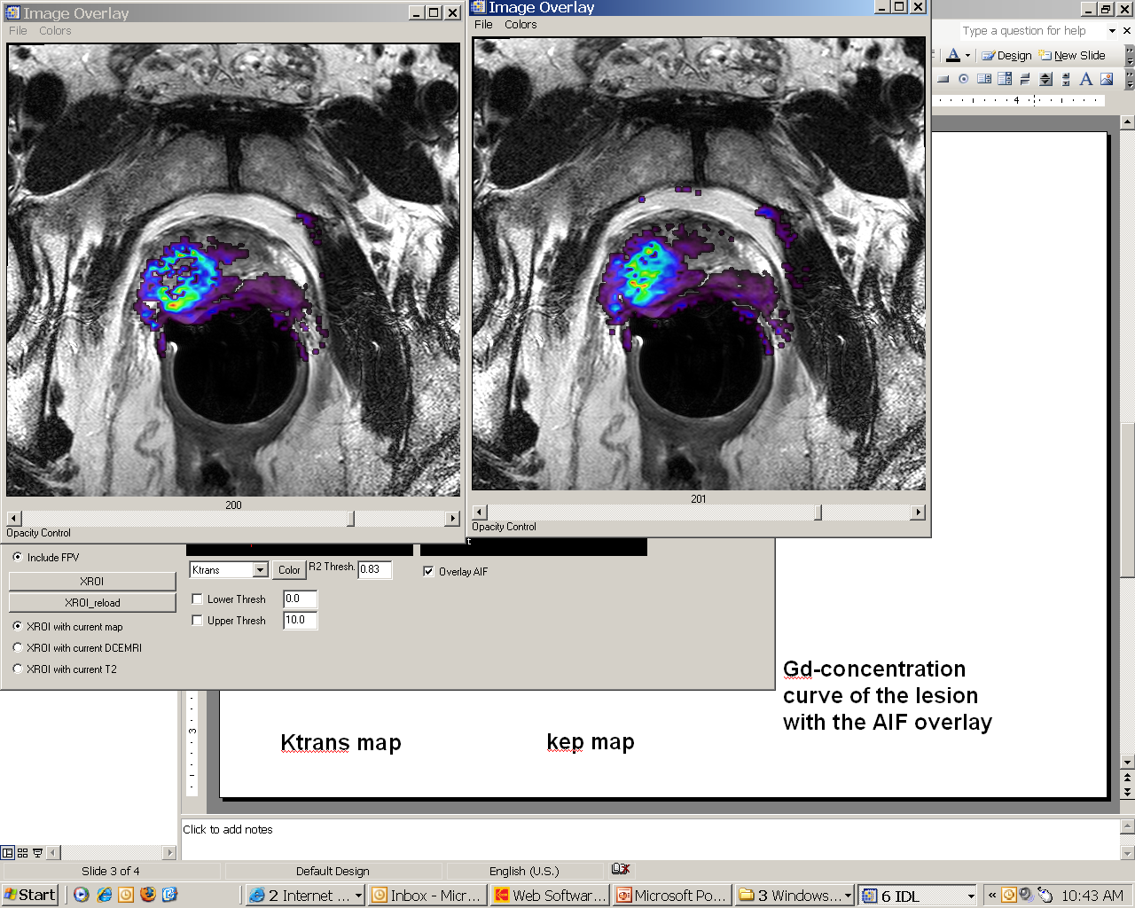
Multiparametric Prostate MRI
DWI
T2W
DCE
MRS

Slide 32
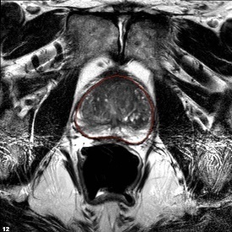
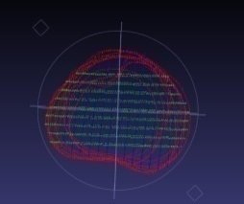
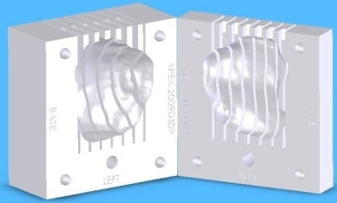
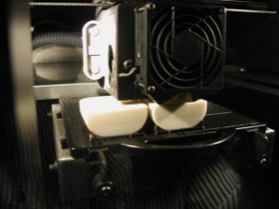
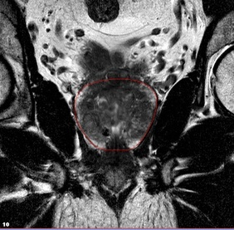
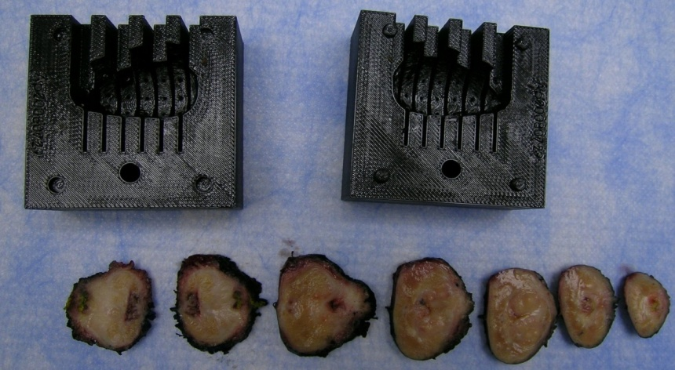
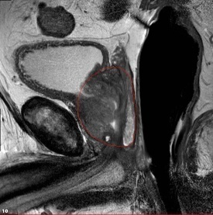
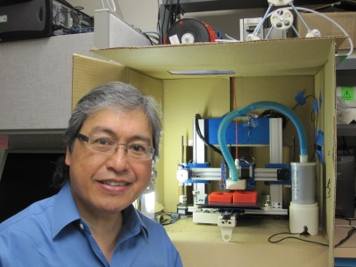
Patient-Specific MR-based Mold
Shah et al. Rev Sci Instrum. 2009 Oct;80(10):104301 (Research Highlight for Oct’09 issue)
T2W
Virtual Mold
3D Printing
Mold
Printed
at CIT, NIH
Tissue Blocks Obtained from Prostatectomy Specimen
Marcelino Bernardo

Slide 33






Is Computer Aided Diagnosis (CAD) More Sensitive?
Reject: low grade Pca, BPH
Intensity
Haralick
T2
Intensity
Haralick
Random Forest
Classifier
ADC
Intensity
Haralick
b2000
Accept: intermed &
High grade PCa
Gleason
≥4+3
Lay N et al. SPIE proceedings 2016

Slide 34

Random Forest Classifier Ron Summers NIH
Jin Tae Kwak et al. Med Physics, 2015

Slide 35








CAD Outperforms Trained Human Readers in Defining Lesion Contours
T2W
ADC
CAD
Lay N et al. SPIE proceedings 2016
Notes:
Anonymized MRN: 19420487
Anonymized Accession: MR730651881
Slide scan from: M:\Baris Turkbey\publications Turkbey\papers\CG tumors vs. BPH\LastName_RealMRN\Histopath
Slice #: 10

Slide 36



3D printing to assist surgical planning
Patient undergoes preoperative MRI
3D Model of the prostate is created from MRI and printed using 3D printer
3D Model used intraoperative to assist with resection of prostate and attention to tumor margins

Slide 37

Prostate Specific Membrane Antigen (PSMA)
PSMA (prostate specific membrane antigen) is a transmembrane protein, which is highly expressed in many prostate cancers, particularly high grade cancers.
Urea-based compounds have high affinity for the enzymatic domain of PSMA and are used for PET imaging
PSMA receptor
http://ajpcell.physiology.org/content/288/5/C975

Slide 38

T2W MRI
ADC map
B=2000 DWI
DCE MRI permeability map
TRUS/MRI fusion guided biopsy Gleason 4+5 prostate cancer
18F-DCFBC PET study localizes the anterior TZ lesion

Slide 39

71-year old man with PSA=4ng/ml after radical prostatectomy.
Courtesy of Dr. Frederik Giesel from University of Heidelberg, Germany

Slide 41

Neuroendocrine Prostate + GaDOTATATE study

Slide 42

Jin Tae Kwak 2016

Slide 43

Precision Dx for Prostate Cancer – U Miami Model: MRI (radiomics) + genomics = radiogenomics
c/o R. Stoyanova, A. Pollack, S. Punnen, Univ. of Miami – Oncotarget 2016
Presented at the First Global Summit on Precision Dx for Prostate Cancer
Notes:
Figure 1. Experimental Design. Multiparametric (MP-)MRI, consisting of anatomical (T2-weighted), perfusion (Dynamic Contrast Enhanced (DCE-)MRI and diffusion (Diffusion Weighted Imaging (DWI)) imaging sequences is acquired on 3T scanner. Upper left-hand side (shaded in blue) denotes the procedures for MRI-ultrasound fused targeted biopsies. The steps for radiomic analysis are presented at the right hand side in green. Histopathology results, gene expression analysis and radiomic features are fed in the radiogenomics analysis.

Slide 44





Improving CAD with Biologic Correlatives
Tumor on mpMRI
Digital histology
Genomic histology
Genomics
Gene enhancers

Slide 45
Case study
Mr. I is a healthy 52 year old male presenting to his primary care doctor for yearly exam
Past Medical History: Diabetes, hair loss
Medications: Metformin, Propecia
Has family history of prostate cancer (Father age 54)
Undergoes prostate cancer screening
Body mass index 38
PSA 5.2ng/ml
Digital rectal exam is normal

Slide 46

Case study
Mr. I worried but wants more information
Free PSA 0.2 (increased risk of finding cancer)
PHI score of 60 (increased risk of finding cancer)

Slide 47

Case study
What are the chances I have prostate cancer?
According to Nomogram: 50%

Slide 48


Prostate biopsy

Slide 49

Prostate biopsy

Slide 50
Prostate biopsy

Slide 51

Biopsy Results
12 core prostate biopsy demonstrates
Prostate volume 50 cc
1/12 cores with prostate cancer
Gleason Pattern 3+3
60% of core

Slide 52

Management
Management options are discussed
Surgery
Radiation
Active Surveillance
Cancer is considered Low risk (D’Amico)

Slide 53
Decision Making Time
Mr. I opts for active surveillance
Requires confirmatory biopsy at 1 year to demonstrates no progression
Repeat PSA at 1 year is stable at 5.3ng/ml
DRE still normal
Decides to undergo prostate MRI and MR/US fusion biopsy
Also decides to have genomic test to characterize cancer

Slide 54
Summary of Active Surveillance Studies
Author | N | Median Follow-up (mo) | pT3 in RP Patients | OS | CSS
van As - Eur Urol. | 326 | 22 | 8/18 44% | 98 | 100
Carter - J Urol. | 407 | 41 | 10/49 20% | 98 | 100
PRIAS | 533-1000 | 48 | 4/24 17% | 90 | 99
Soloway | 99 | 45 | 0/2 | 100 | 100
Roemeling | 278 | 41 |  | 89 | 100
Khatami | 270 | 63 |  | Not stated | 100
Klotz - J Clin Oncol. | 452 | 73 | 14/24 58% | 82 | 97 @ 10 yr
Total | 2130-3000 | 43 |  | 90 | 99.7
CSS=cancer-specific survival; mo=months; OS=overall survival; p=pathologic; RP=radical prostatectomy.

Slide 55

MRI-TRUS Fusion Prostate Biopsies

Slide 56

Prospective study 2007-2014
Analysis of 1003 men biopsied for suspicion of prostate cancer
MRI targets on all patients
Targeted biopsies and standard 12-core biopsies performed on all men

Slide 57
Key findings:
30% increase in the diagnosis of high-risk cancers using targeted biopsy
17% decrease in the diagnosis of clinically-insignificant low risk cancers

Slide 58

Mr. I MRI
Underwent MP-MRI
3 lesions seen
PIRADSv2 suspicion score 3 for all lesions
MR/US Fusion Biopsy with standard 12-core sampling
12-core biopsy pathology
1 out of 12 with Gleason 3+3, 50% of core positive
Targeted biopsy pathology
Lesion 1 (blue): Gleason 3+3, 50%
Lesion 2 (blue): Gleason 3+3, 30%
Lesion 3 (green): Gleason 3+4, 20%

Slide 59


Genomic Characterization
Decipher
High density array (1.4 million probes)
22 genes are used for risk profile
Reports genomic signature
Mr. I comes back as high-risk
Karnes et al J Urol 2013, Cooperberg et al Eur Urol 2015, Ross et al Eur Urol 2015, Klein et al Eur Urol 2015, Klein et al Urology 2016, Nguyen et al PCPD 2016
Notes:
One area where there are limited data

Slide 60

Which is more helpful for active surveillance: Genomics or Imaging?
Tumor heterogeneity mandates appropriate sampling
Genomics provides molecular characterization of tumor potential
Hong MK et al. Tracking the origins and drivers of subclonal metastatic expansion in prostate cancer. Nature Communications. 2015 Apr 1; 6:6605

Slide 61
Which is more helpful for active surveillance: Genomics or Imaging?
Tumor heterogeneity mandates appropriate sampling
Genomics provides molecular characterization of tumor potential
Imaging and Genomics are complementary, not exclusive!

Slide 62
Targeted biopsy results
Prostate cancer grade now up to Gleason 3+4
but…
% Gleason Pattern 4 is low
Maximal PIRADS score was 3
PSA is stable
Genomic classifier is low risk
yet….
Cancer is now considered Intermediate risk (D’Amico)

Slide 63
Discussion with patient
Management options are discussed
Surgery
Radiation
Active Surveillance
Based on Gleason 7, now intermediate risk cancer
Surgery recommended

Slide 64

Prostate Cancer Metabolism
Cancer often has deranged metabolic processes
Prostate has fundamental alterations in the Krebs cycle
Deranged metabolism can be used to risk-stratify cancer

Slide 65
Data gathered during patient encounter
Patient age
Medical comorbidities
Diabetes
Male pattern baldness
Medications
Metformin
Propecia
Family cancer history
Vital signs / BMI
Physical Exam / DRE
Blood test (PSA, free PSA, PHI)
Prostate Ultrasound
Prostate volume
Prostate cancer tissue pathology
Gleason score
Tumor length
Tumor focality (# of cores)
Prostate MR imaging
Prostate cancer gene expression

Slide 66
Data used during patient encounter
Patient age
Medical comorbidities
Diabetes
Male pattern baldness
Medications
Metformin
Propecia
Family cancer history
Vital signs / BMI
Physical Exam / DRE
Blood test (PSA, free PSA, PHI)
Prostate Ultrasound
Prostate volume
Prostate cancer tissue pathology
Gleason score
Tumor length
Tumor focality (# of cores)
Prostate MR imaging
Prostate cancer gene expression
Physical Exam / DRE
Blood test (PSA, free PSA, PHI)
Prostate cancer tissue pathology
Gleason score
Tumor length
Tumor focality (# of cores)
Prostate MR imaging
Prostate cancer gene expression

Slide 67

Opportunities for improved personalized risk-stratification
Ultrasound
Pathology
MRI
Genomics
Normal /
Not normal
Gleason
6-10
PIRADS
1-5
Low
Intermediate
High Risk
Metabolism
Future information sources?
Emerging biomarkers

Slide 68

Thank you…

